Slide 1
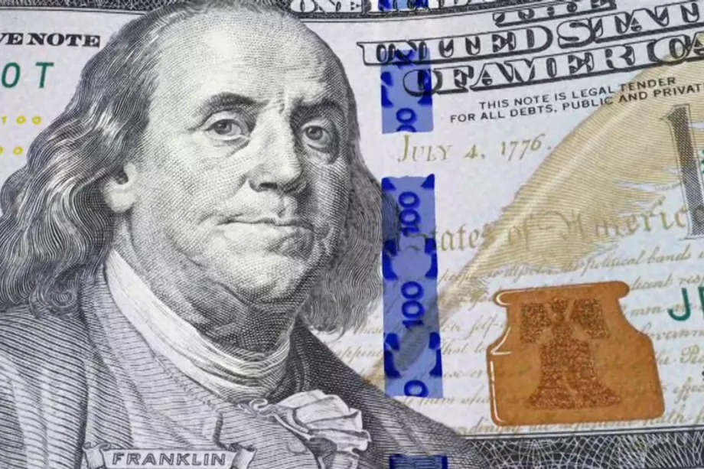
Recession and Expansion
Beau Batchelor
Julie Nguyen

Slide 2
Recession Definition
“a period of temporary economic decline during which trade and industrial activity are reduced, generally identified by a fall in GDP in two successive quarters.”
Usually reported on by the National Bureau of Economic Research.
Can be late or seen as politically motivated.

Slide 3
Collecting known economic indicators.
Surveys of Consumers, University of Michigan, University of Michigan
U.S. Office of Management and Budget, Federal Surplus or Deficit
Velocity of M2 Money Stock
Copper future prices
Total Oil inventory
Unemployment Rate
Yield Spread
GDP percent change
One and Ten Year Bond Rates
Discount Rate

Slide 4
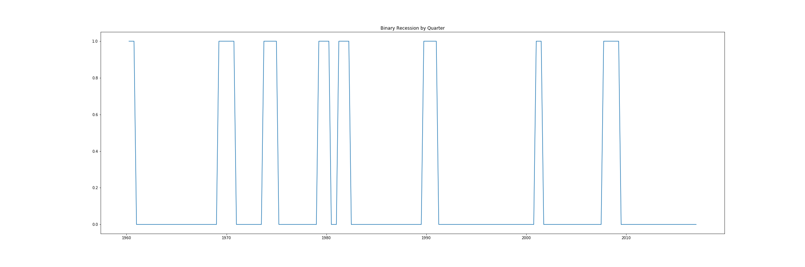
Our historical recession data
GDP-Based Recession Indicator Index
The series assigns dates to U.S. recessions based on a mathematical model of the way that recessions differ from expansions. Whereas the NBER business cycle dates are based on a subjective assessment of a variety of indicators, the dates here are entirely mechanical and are calculated solely from historically reported GDP data.

Slide 5
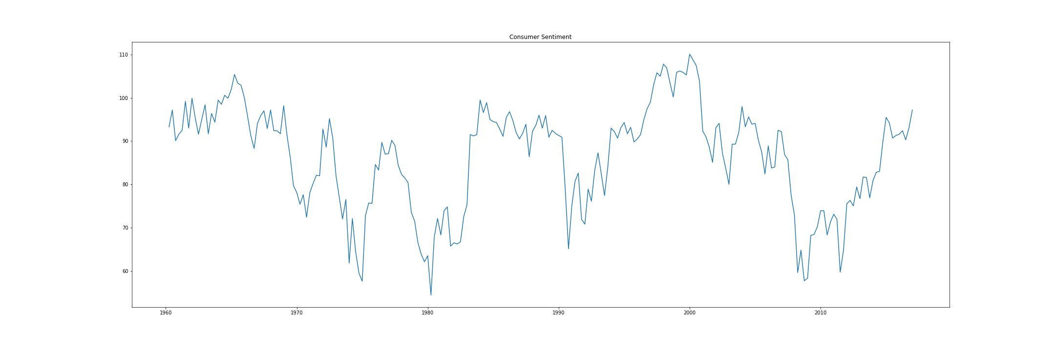
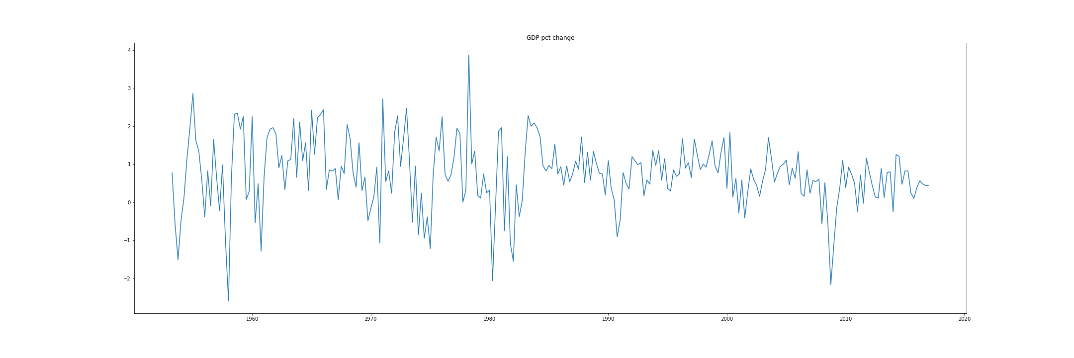
Consistent Indicators

Slide 6
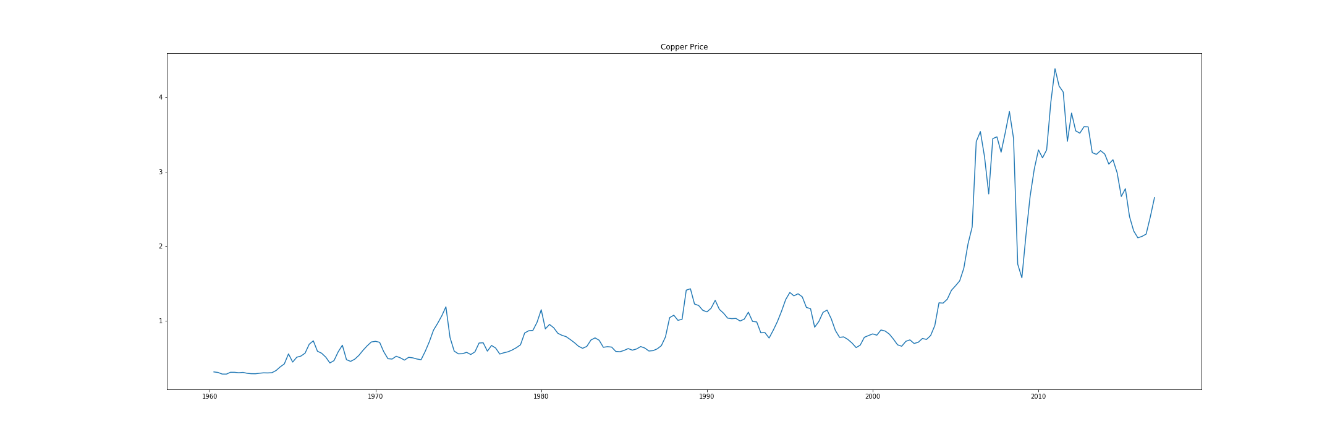
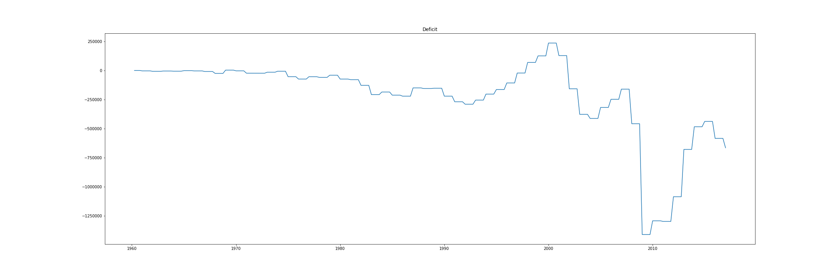
Inconsistent Indicators

Slide 7
We Used..
Requests
To collect all of our data via APIs.
Datetime
To convert all the date strings.
Pandas
To connect all the data.
Matplotlib
To test our data’s relevance.
SKLearn Support Vector Classification
To create our model.

Slide 8
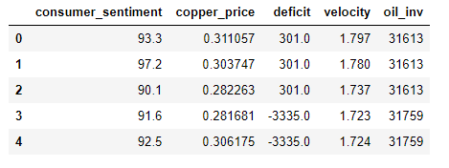
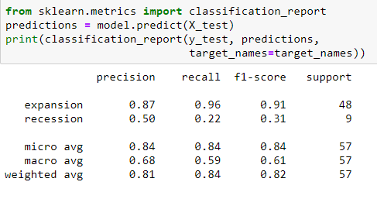
First Test

Slide 9
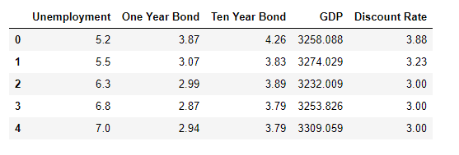
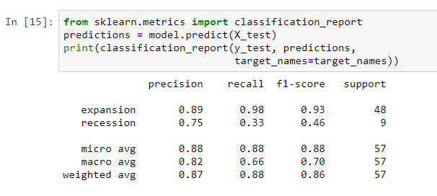
Second Test

Slide 10
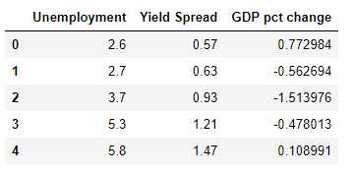
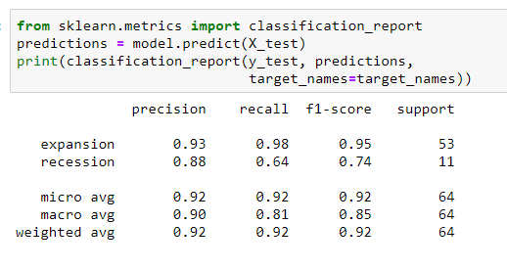
Third Test

Slide 11
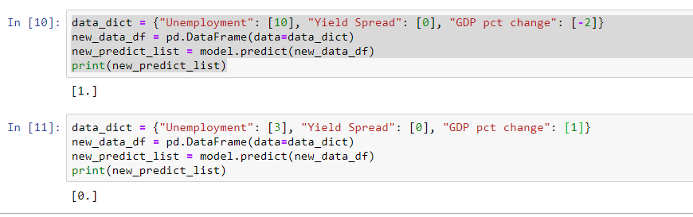
New Data Hook Up

Slide 12
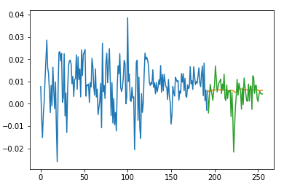
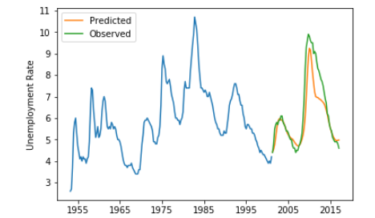
With More Time
Would create a model that could project for each indicator.
Review each indicator’s relation to recession.

